Slide 1
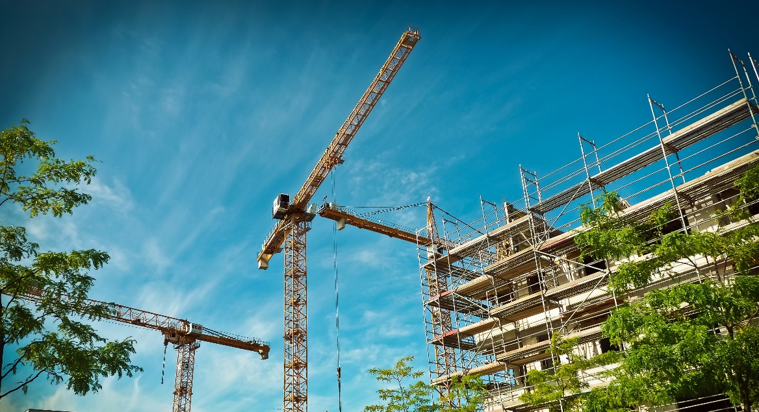
Untapping the potential of locally available secondary raw materials for a more sustainable urban construction sector trough a circular economy business model

Slide 2
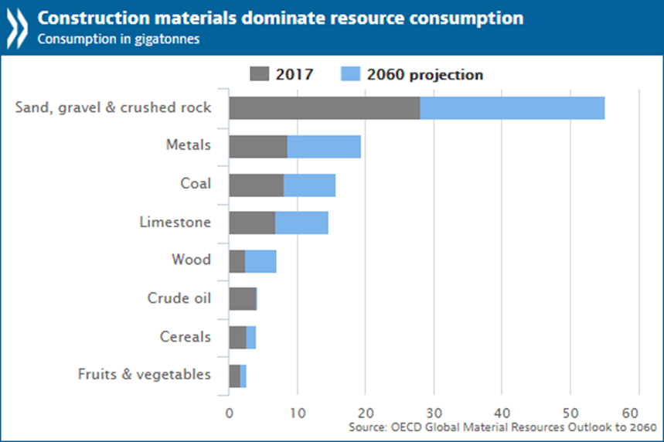
Construction sector
Globally the construction sector more than doubles between 2017-2060 as does its use of materials, leading to almost 84 Gt construction materials use per year in 2060.
Economic development, investment, construction activity and construction materials are closely linked.
Construction sector is mostly driven by investment needs.
Expansion of construction sector leads to an increase in construction materials use including consumption of raw materials.
Source: OECD, Global Material Resources Outlook to 2060: Economic Drivers and Environmental Consequences.
Published on February 12, 2019.

Slide 3
Circular economy in construction sector is a must
In Europe, construction sector uses about half of all materials extracted, half of all energy consumed and one third of all water consumed.
It also generates one third of all EU waste.
The challenge arises to let the decrease of the environmental impact of construction sector go hand in hand with resourceful use of materials and economic growth.
Source : CINDERELA 2019

Slide 4
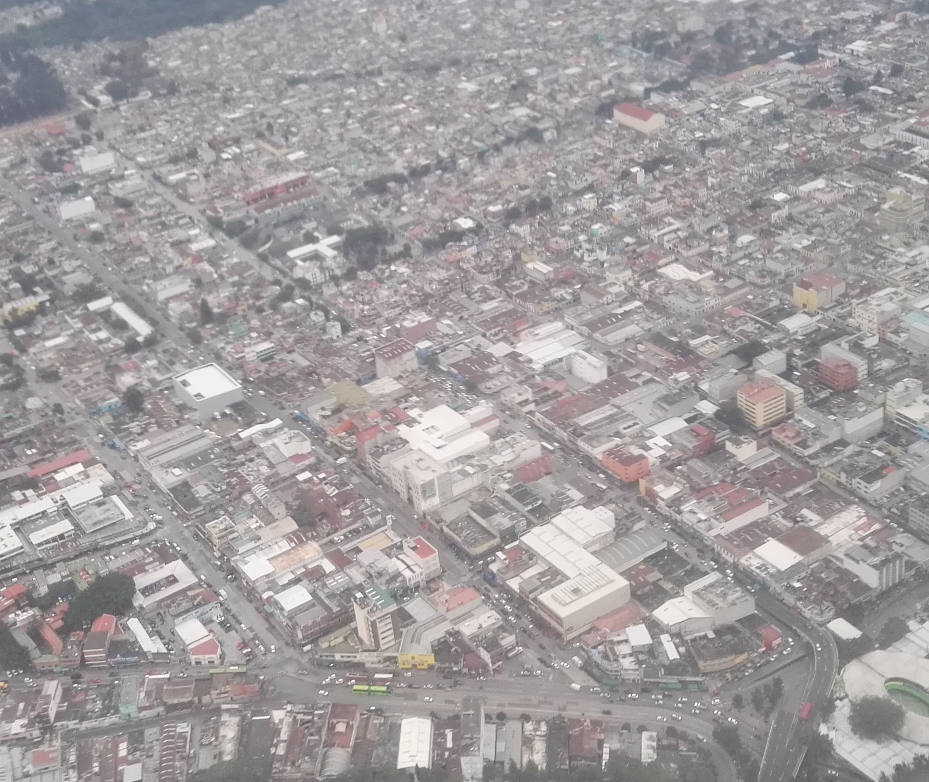
The potential of urban areas
Construction activities are mainly located in urban and peri-urban areas due to investment opportunities.
86% of the developed world is expected to live in urban areas by 2050.

Slide 5
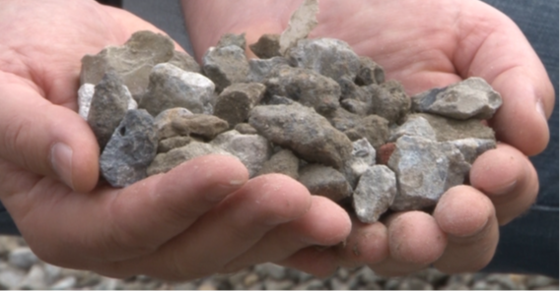
The potential of urban areas
Urban and peri-urban areas generate tons of different waste types that are currently unused such as:
  construction and demolition waste,
  waste from industries,
  waste from municipal services,
They could be turned into a valuable source of secondary raw materials (SRM) for the construction sector available locally and at hand if only adequate business practices, technologies and specialized knowledge were in place.

Slide 6
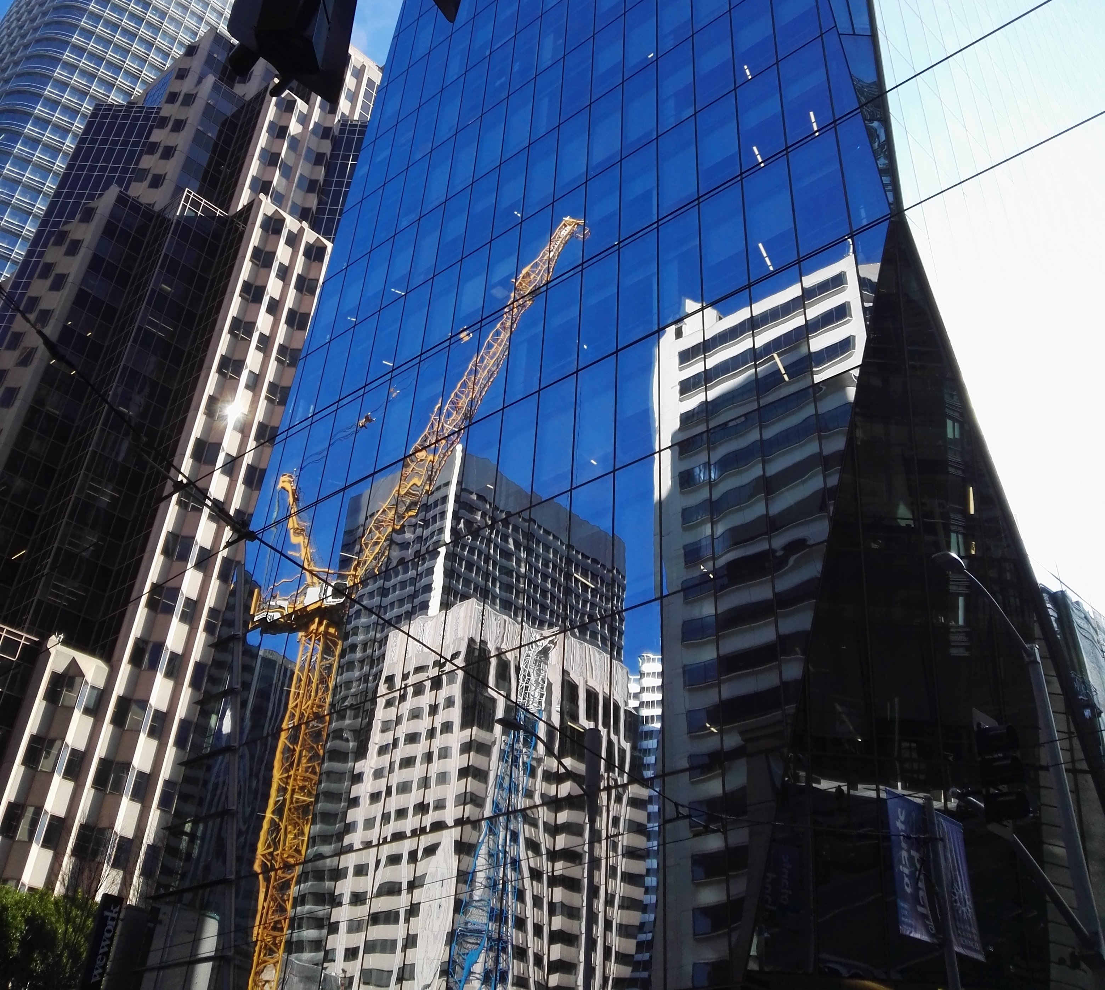
CINDERELA boosts the waste to resource in construction
CINDERELA develops and demonstrates a circular economy business model (CinderCEBM) aided by a One-Stop-Shop digital environment (CinderOSS) to help construction companies find how they can profit and deliver value to clients thanks to turning SRM recovered from urban waste streams into construction materials for building and civil engineering applications.
Construction sector offers an enormous potential for setting the circular economy business case.

Slide 7
CINDERELA project in brief
CINDERELA (New Circular Economy Business Model for More Sustainable Urban Construction) is a large-scale demonstration project implemented under the flagship of the Horizon 2020 - Research and Innovation Programme of the European Union
Project title: New Circular Economy Business Model for More Sustainable Urban Construction
Project Acronym: CINDERELA
Project Number: 776751
Starting date: 01/06/2018
Duration in months: 48
Budget: 7,635,365.25 EUR
Project Coordinator: Slovenian National Building and Civil Engineering Institute (ZAG)
Project partners: Bocconi University, Bexel Consulting, OpenContent, Fundación Gómez Pardo, TECNALIA, NIGRAD, IETU, AEDHE, TUDelft, 6.MAJ, Polo Tecnologico di Pordenone, KplusV
www: www.cinderela.eu e-mail: info@cinderela.eu

Slide 8
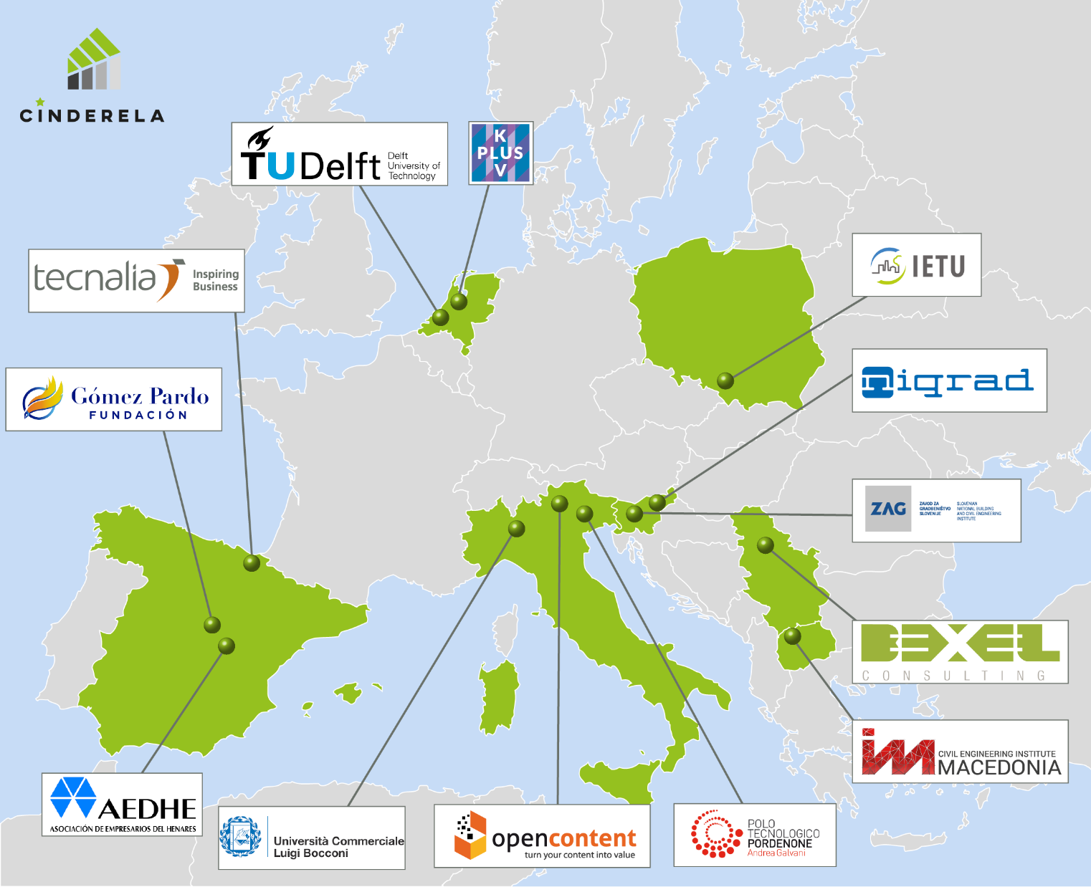
CINDERELA consortium

Slide 9
CINDERELA action lines
1
assessing waste to resource opportunities
2
circular business model building
3
design, development and testing
4
pilot demonstrations
5
environmental, economic & social assessments

Slide 10
Asessing waste to resource opportunities
Source: REPAiR (REsource
Management in Peri-urban AReas: Going Beyond Urban Metabolism, http://h2020repair.eu/).
Define what is available and where
An open source and GIS supported tool GDSE (Geodesign Decision Support Environment), enables predicting the most optimal waste-to-product solution based on waste availability, quantity, and location.
Valorize waste potential for recycling into SRM-based construction products
CINDERELA develops a set of criteria that need to be taken into account by companies in order to have an understanding of the activities required to make their business model work in terms of composition, quantity, quality, availability and recyclability of wastes according to their intended use in construction works.
Valorisation of waste streams using Material Flow Analysis (MFA) based on the Geodesign Decision Support Environment (GDSE) tool.

Slide 11
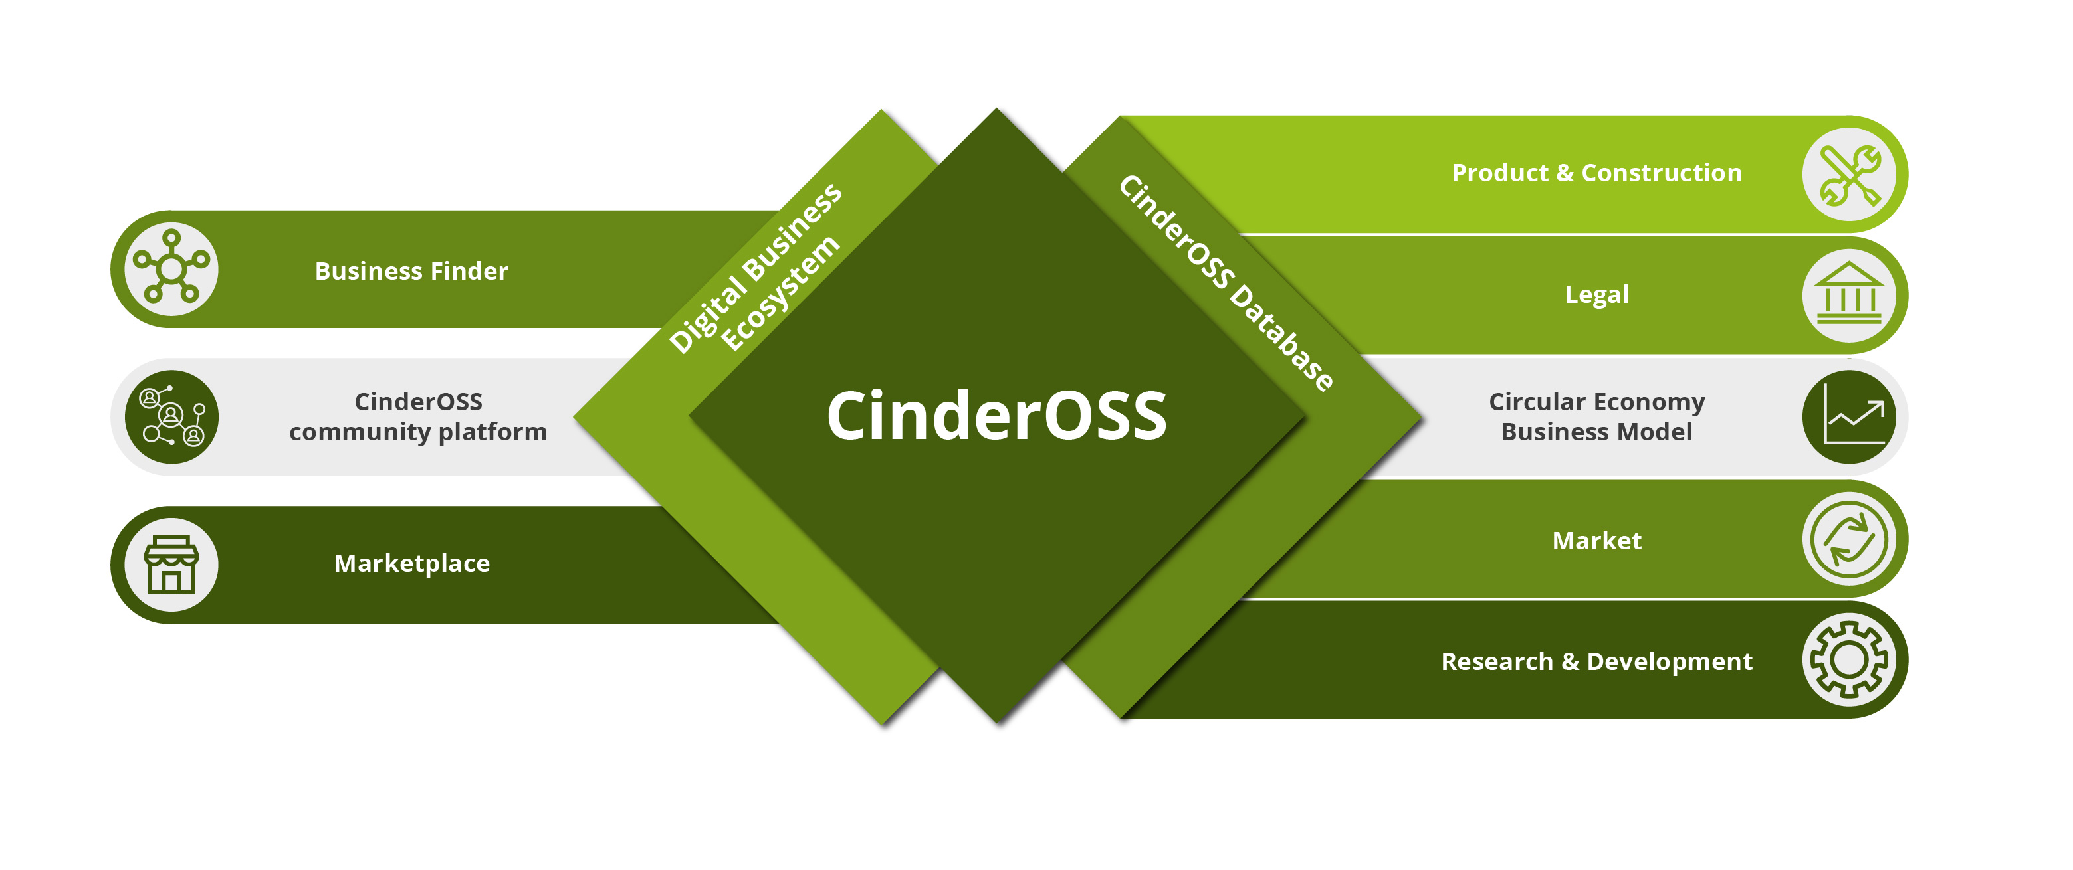
Circular business model building
CinderOSS provides a digital environment enabling setting of circular business models depending on local/regional conditions together with information on SRM availability and the associated stakeholders.

Slide 12
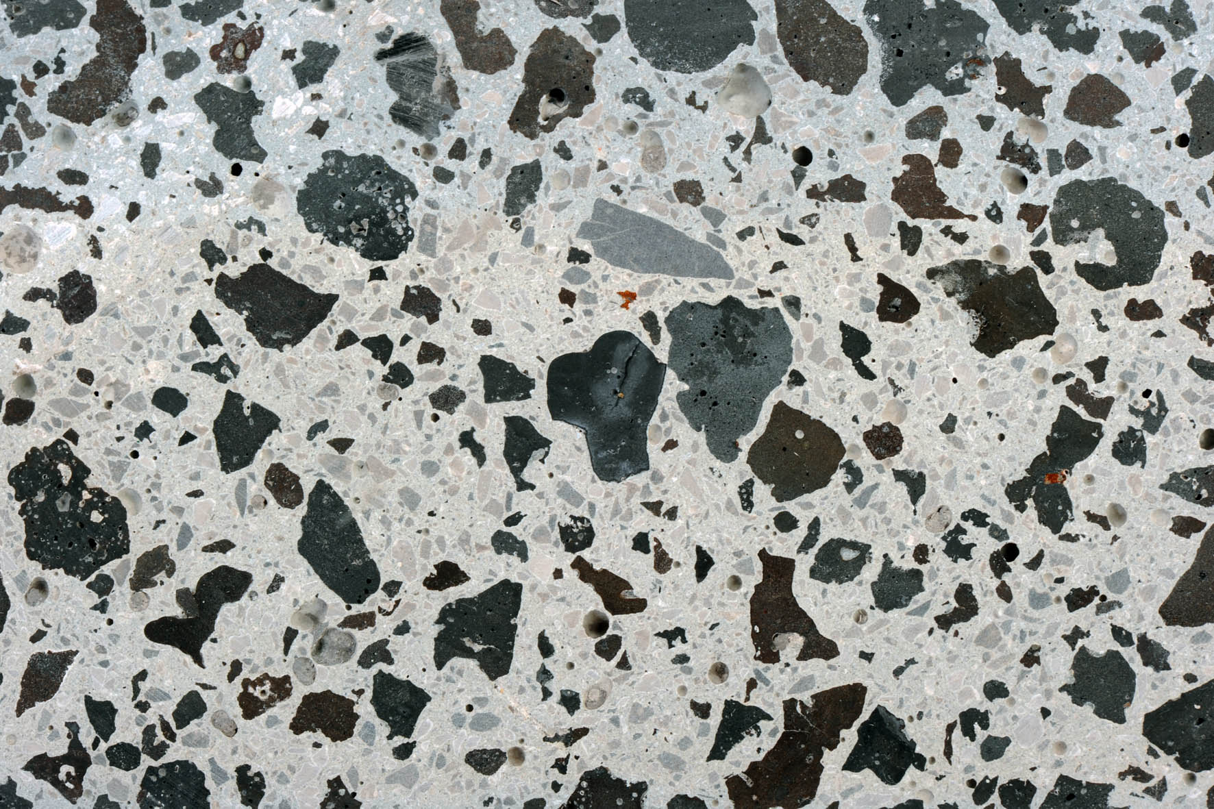
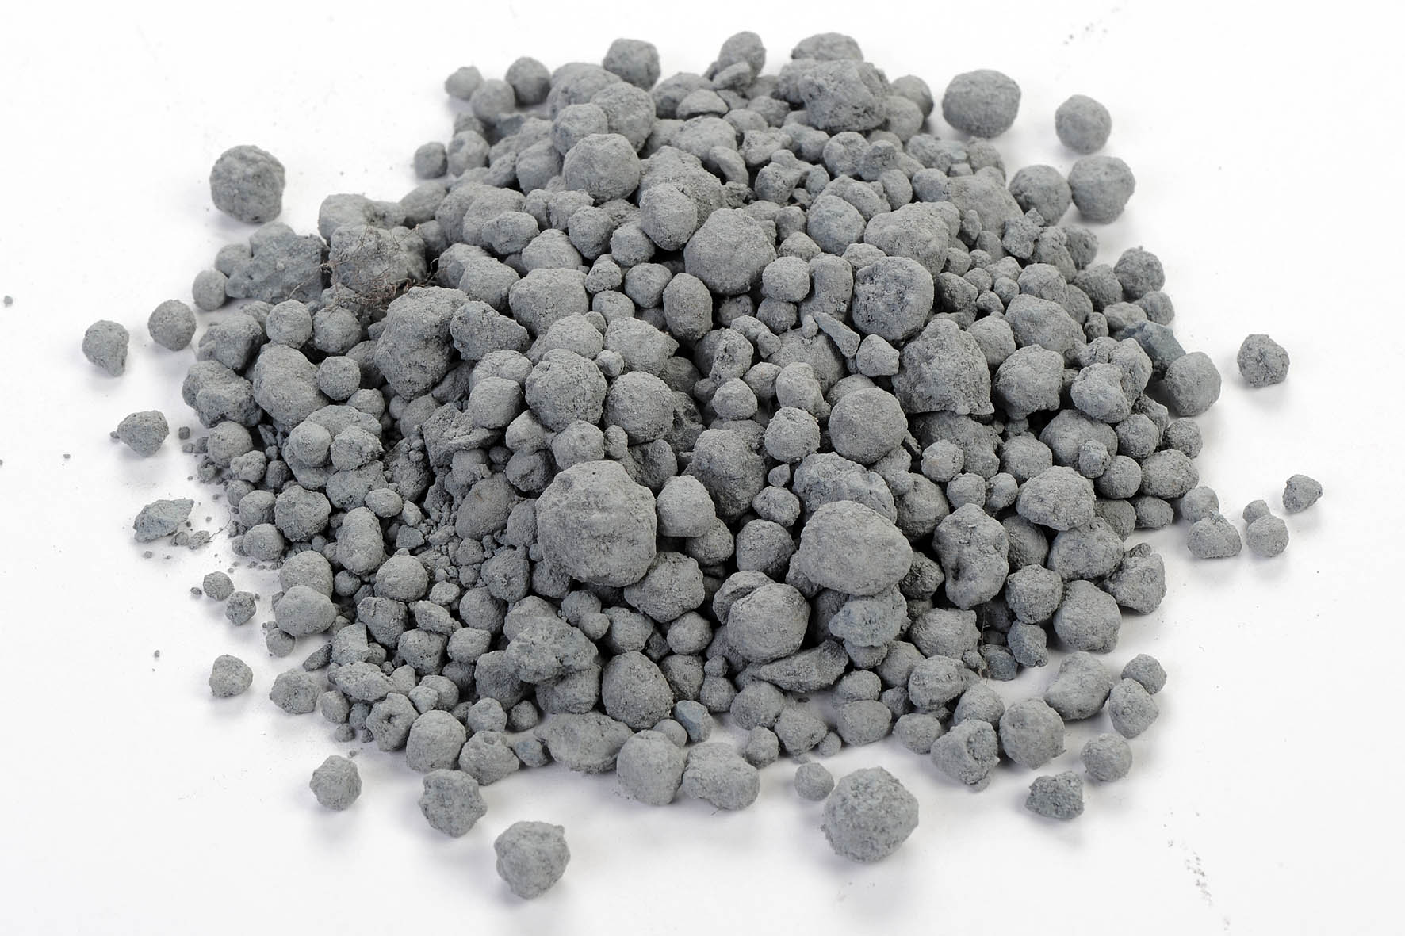
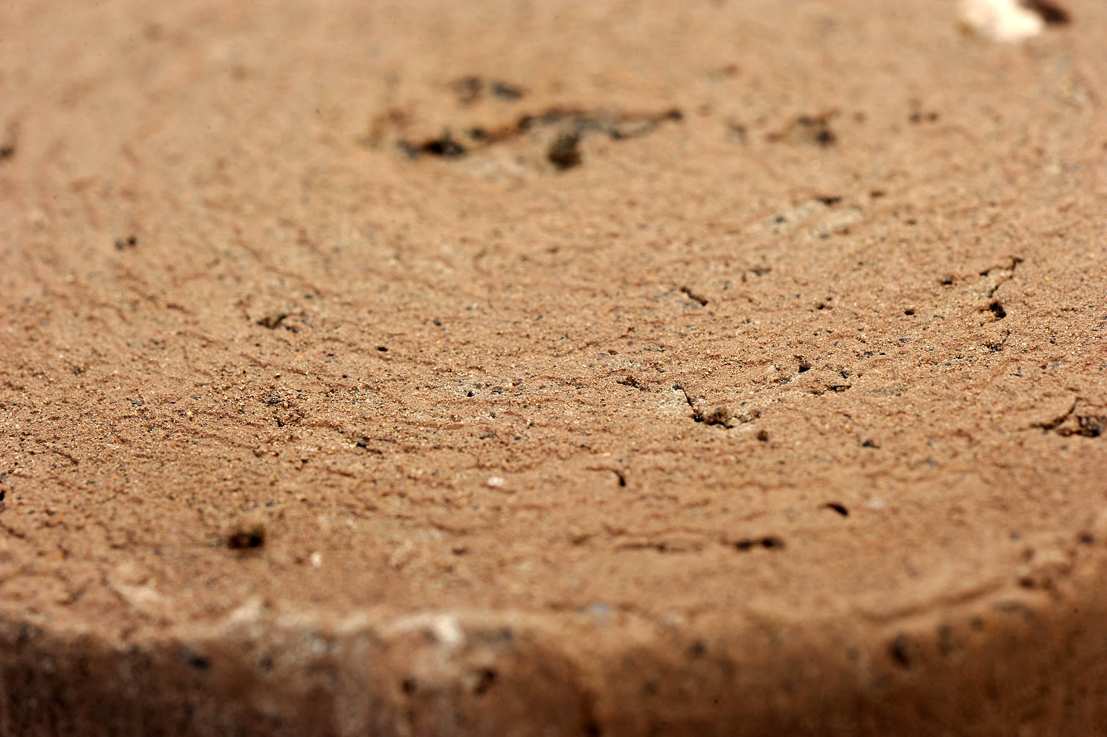
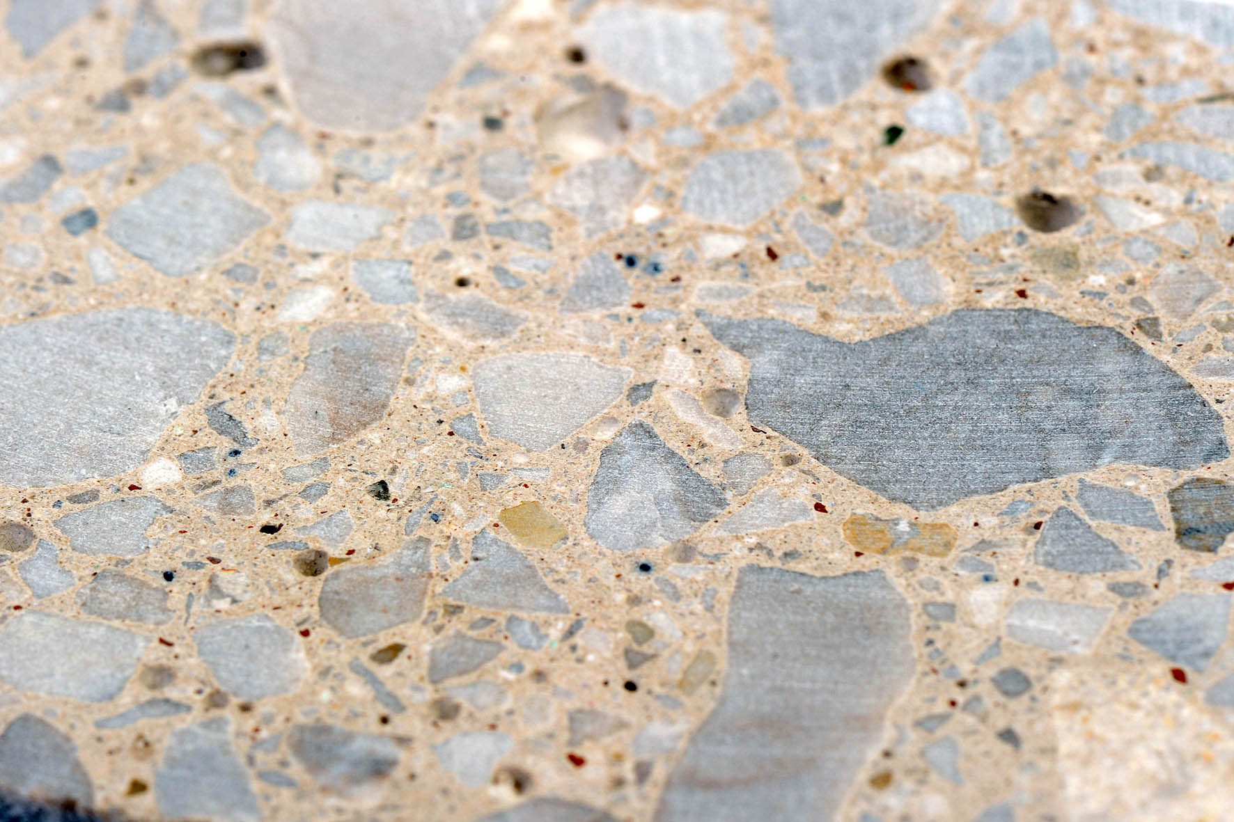
Design, development and testing
Targeted waste types
SRM-based construction products and materials:
Construction & demolition waste
Certain types of industrial waste
  e.g. waste from thermal processes (slags, sludges) from power and incineration plants, iron, steel & glass industry, extractive/mining industry etc.
Waste generated by municipal services
  e.g. inert heavy fraction from municipal solid waste and sewage sludge from municipal waste water treatment, some fractions of municipal waste e.g. plastics.
Recycled aggregates
  e.g. aggregate from recycled construction and demolition wastes.
Manufactured aggregates
  e.g. aggregates from recycled industrial wastes.
Hydraulically bound and unbound construction composites
  e.g. green concretes.
Recycled soils.

Slide 13
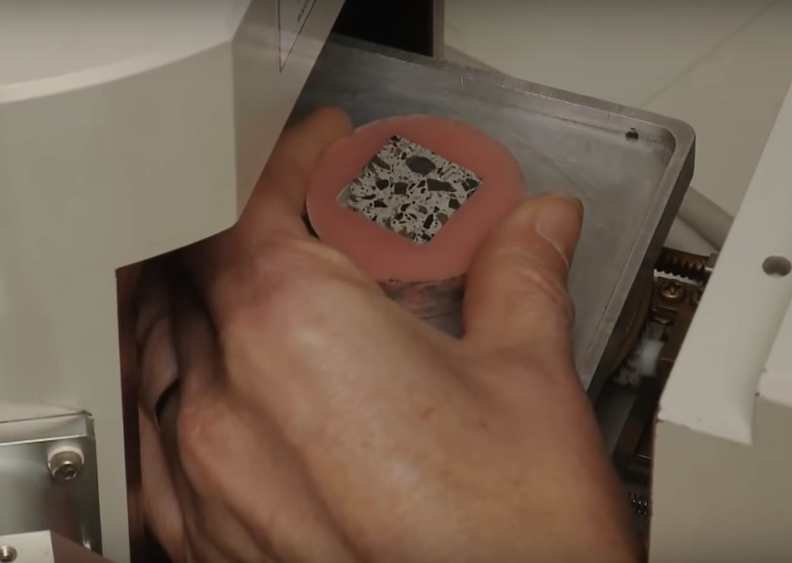
Design, development and testing
New SRM-based construction products will be prototyped and tested according to the technical specifications relevant for their intended final use.
The test data will be used to:
  design and establish the modular as well as mobile pilot production plants for recycled and manufactured aggregates, building composites and recycled soils;
  demonstrate their use in the large scale construction demos.

Slide 14
CINDERELA Demos and use cases
To ensure its usefulness across Europe, CinderOSS as a systemic approach and a framework for the implementation of CinderCEBM will be tested in different socio-economic environments.
Technological and systemic demonstration will be done in Slovenia, Spain and Croatia.
Additionally, the applicability of CinderCEBM aided by CinderOSS as a systemic approach will be tested in the Netherlands, Italy and Poland.

Slide 15
CINDERELA Demo Pilots

Slide 16
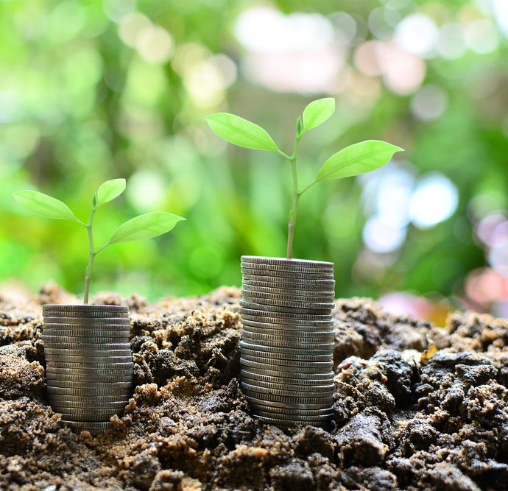
Environmental, economic & social assessments
The project will contribute to
20% reduction of environmental impacts along the value and supply chain, reducing virgin material exploitation and converting wastes to products.
Sustainability of CinderelaCEBM will be proven with the environmental, economic and social assessment through whole life (LCA, LCC and S-LCA).
Environmental performance of the SRM-based construction materials will be assesed using Environmental Technology Verification (ETV) scheme.

Slide 17

Benefits of CINDERELA
creates new business opportunities for construction industry and SMEs based on waste materials available locally/regionally;
provides evidence based knowledge on the enabling framework conditions for design, production and use of SRM-based construction materials;
helps build confidence in innovative SRM-based construction materials providing reliable test data on their performance based on testing protocols in line with the construction sector requirements.
CINDERELA mobilizes stakeholders and resources for circular economy implementation in the construction sector on local/regional level.

Slide 18




More info on CINDERELA
Contact us: info@cinderela.eu
Visit our website: https://www.cinderela.eu/
Follow us on LinkedIn: https://www.linkedin.com/in/cinderela-project-7329ba16a/
Follow us on Twitter: https://www.twitter.com/CinderH2020

Slide 19


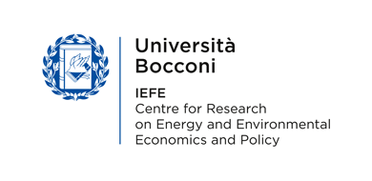












CINDERELA Partners
This project has received funding from the European Union’s Horizon 2020 research and innovation Programme under grant agreement N° 776751

